Slide 1
6-Weeks Summer Internship on Machine Learning and Generative AI with Python

Slide 2
Operators in Python
Operators are special symbols used to perform operations on variables and values.
They help in calculations, comparisons, and logical decision-making.
Python provides different types of operators for different tasks.

Slide 3
Types of Operators in Python
Arithmetic Operators
Comparison Operators
Logical operators
Assignment Operators
Membership Operators
Identity Operators

Slide 4
Arithmetic Operators
Operator Meaning Example
+ Addition 10 + 5 = 15
- Subtraction 10 - 5 = 5
* Multiplication 10 * 5 = 50
/ Division 10 / 5 = 2
% Modulus 10 % 3 = 1
** Exponent 2 ** 3 = 8
// Floor Division 10 // 3 = 3

Slide 5
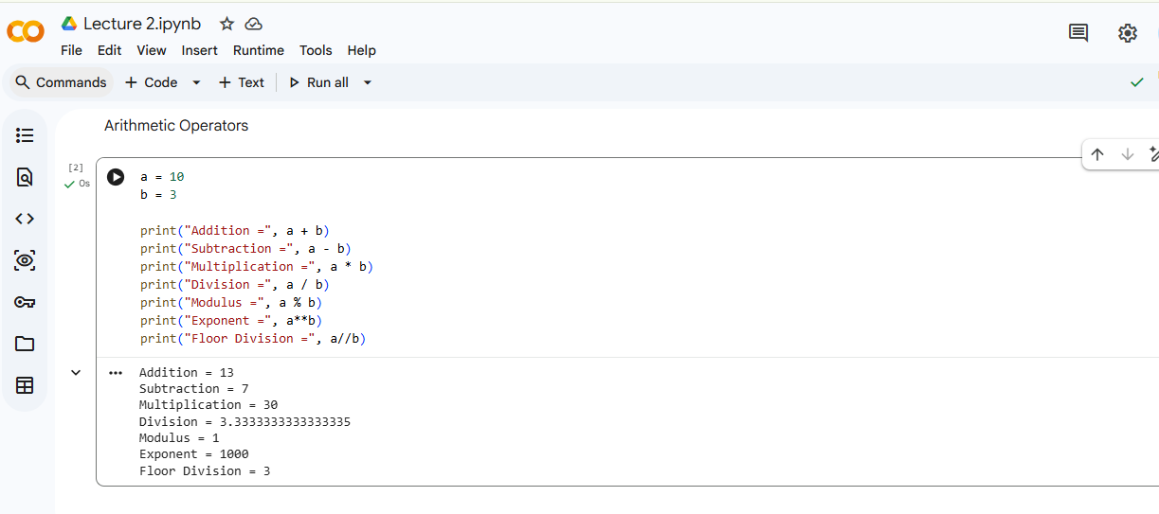

Slide 6
Comparison Operators
Operator Meaning
== Equal to
!= Not equal to
> Greater than
< Less than
>= Greater than or equal to
<= Less than or equal to

Slide 7
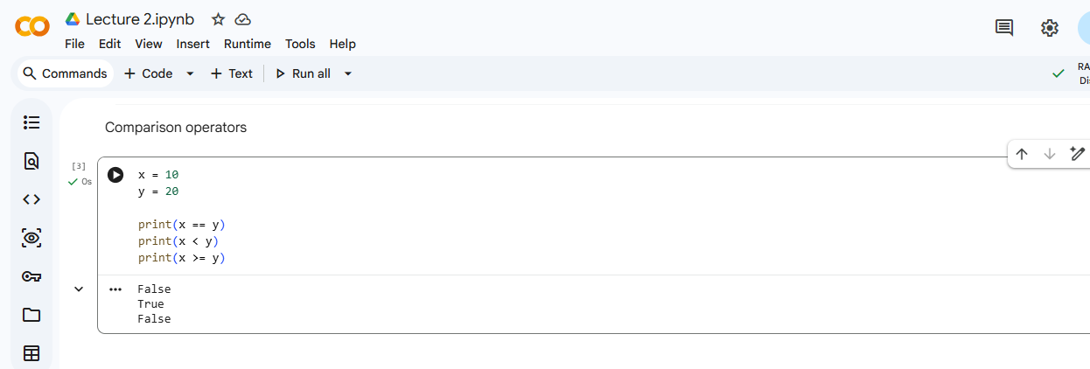

Slide 8
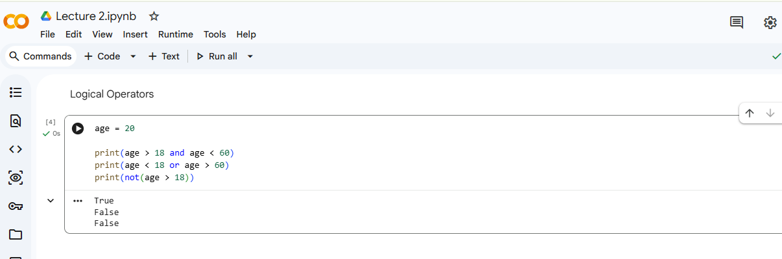
Logical Operators
Operator Meaning
and Returns True if both conditions are True
Or Returns True if at least one condition is True
Not Reverses the result

Slide 9
Assignment Operators
Operator Example
= x = 10
+= x += 5
-=x -= 5
*=x *= 2
/=x /= 2

Slide 10
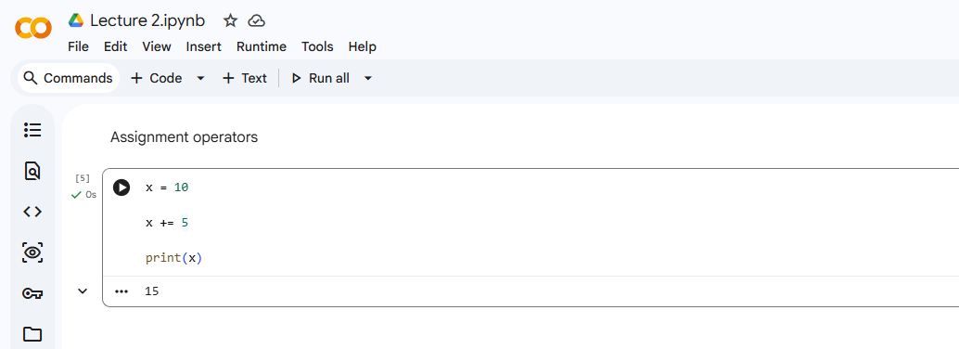

Slide 11
Membership Operators
Used to check whether a value exists in a sequence.
Operator Meaning
in Value exists
not in Value does not exist

Slide 12
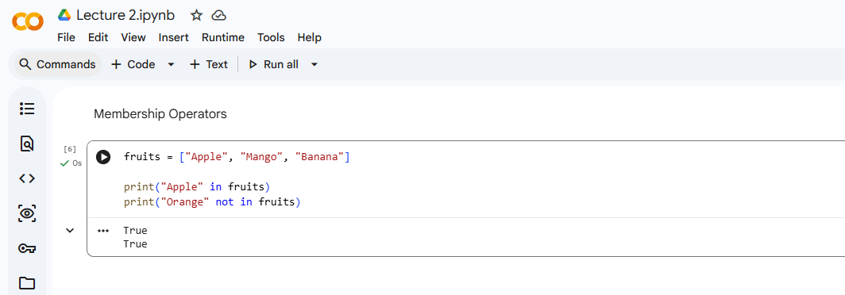

Slide 13
Identity Operators
Used to compare whether two variables refer to the same object.
Operator Meaning
is Same object
is not Different object
Example
a = [1, 2, 3]
b = a
print(a is b)

Slide 14
Summary
Arithmetic operators perform calculations.
Comparison operators return True or False.
Logical operators combine conditions.
Assignment operators update variable values.
Membership operators check presence of values.
Identity operators compare objects.

Slide 15
Exercise
1. Find the Output
x = 10
y = 5
print(x + y)
print(x > y)
print(x == y)
print(x % y)

Slide 16
2. Find remainder when one number is divided by another.
3. Find Square of a Number
4. Find Cube of a Number
5. Calculate Area of Rectangle
6. Calculate Area of Circle
7. Calculate Simple Interest
8. Average of 3 Numbers

Slide 17
9. What could be the output of the following code:
a) print(10 + 5 * 2)
b) print(20 / 5 + 3)
c) print(10 % 3)
d) print(2 ** 4)
e) print(17 // 5)

Slide 18
Expressions in Python
An expression is a combination of values, variables, operators, and function calls.
Expressions are evaluated by Python to produce a result.
Expressions can perform calculations, comparisons, and logical operations.
General Form of an Expression
operand operator operand
Example
10 + 5

Slide 19
Types of Expressions
Arithmetic Expressions: Used for mathematical calculations.
Example,
a = 10
b = 5
result = a + b
print(result)
Comparison Expressions: Used to compare values.
Example,
x = 10
y = 20
print(x < y)

Slide 20
Logical Expressions: Used to combine multiple conditions. Example,
age = 25
print(age > 18 and age < 60)
String Expressions: Expressions can also work with strings. Example,
first_name = "Rahul"
last_name = "Sharma“
full_name = first_name + " " + last_name
print(full_name)

Slide 21
Expression Evaluation & Operator Precedence
Python Follows Precedence Rules
Precedence Order
Parentheses ( )
Exponent **
Multiplication/Division * / // %
Addition/Subtraction + -

Slide 22
Exercise
Find the Output
print(5 + 3 * 2)
print((5 + 3) * 2)
a = 10
b = 5
print(a > b)
4. x = 20
y = 10
print(x + y * 2)

Slide 23
Control Flow in Python
Control Flow determines the order in which statements are executed.
By default, Python executes statements sequentially.
Sometimes we need:
Decision Making
Repetition
Branching
These are achieved using Control Flow Statements.

Slide 24
Types of Control Flow
Control Flow
│
├── Sequential Flow
│
├── Conditional Flow
│ ├── if
│ ├── if-else
│ └── if-elif-else
│
└── Iterative Flow
├── for loop
└── while loop

Slide 25
Sequential Flow
Sequential Execution - Statements execute one after another.
Example
print("Step 1")
print("Step 2")
print("Step 3")

Slide 26
Conditional Flow
Decision Making in Python
Conditional statements help the program choose different actions based on conditions.
Types
i. if
ii. if-else
iii. if-elif-else

Slide 27
if Statement
Syntax
if condition:
statement
Example
age = 20 if age >= 18: print("Eligible to Vote")

Slide 28
if-else Statement
Syntax
if condition: statement1
else: statement2
Example
age = 16
if age >= 18:
print("Eligible")
else:
print("Not Eligible")

Slide 29
if-elif-else Statement
Multiple Conditions
Syntax
if condition: statement1
elif:
statement2
else: statement3
Example
marks = 75
if marks >= 90:
print("Grade A")
elif marks >= 75:
print("Grade B")
else:
print("Grade C")

Slide 30
Nested if
if Inside Another if
Example
age = 25
if age >= 18:
if age < 60:
print("Working Age Group")

Slide 31
Exercise
Predict the Output
x = 10
if x > 5:
print("A")
else:
print("B")

Slide 32
Iterative Programming
Iteration means repeating a set of instructions.
Used when the same task must be performed multiple times.
Python provides:
for loop
while loop

Slide 33
for Loop
Syntax
for variable in sequence:
statements
range() Function : used to repeat a block of code for a specific number of times in for loop.
range (start, stop, step)
for i in range (5):
print (i)

Slide 34
Example: Multiplication Table
num = int(input("Enter Number: "))
for i in range(1,11):
print(num, "x", i, "=", num*i)
Ques. Generate the given patterns:
a) *
**
***
****
*****
b) *****
****
***
**
*

Slide 35
c) *****
*****
*****
*****
*****
d) 1
12
123
1234
12345

Slide 36
while Loop
Syntax
while condition:
statements
Example
count = 1
while count <= 5:
print(count)
count += 1

Slide 37
break Statement
Stops the loop immediately.
Example
for i in range(1,11):
if i == 5:
break
print(i)

Slide 38
continue Statement
Skips current iteration.
Example
for i in range(1,6):
if i == 3:
continue
print(i)

Slide 39
Exercise
Print numbers from 1 to 10.
Print first 10 even numbers.
Print multiplication table of any number.
Check whether a person is eligible to vote.
Display student grade based on marks.
Print factorial of a number
Reverse a number

Slide 40
Assignment 2
Find sum of first 10 natural numbers.
Find factorial of a number.
Print Fibonacci Series.
Find largest among 3 numbers.
Create Student Result System
- Input student details
- Input marks
- Calculate percentage
- Display grade
- Use:
if-elif-else
loops
user input

